Slide 1
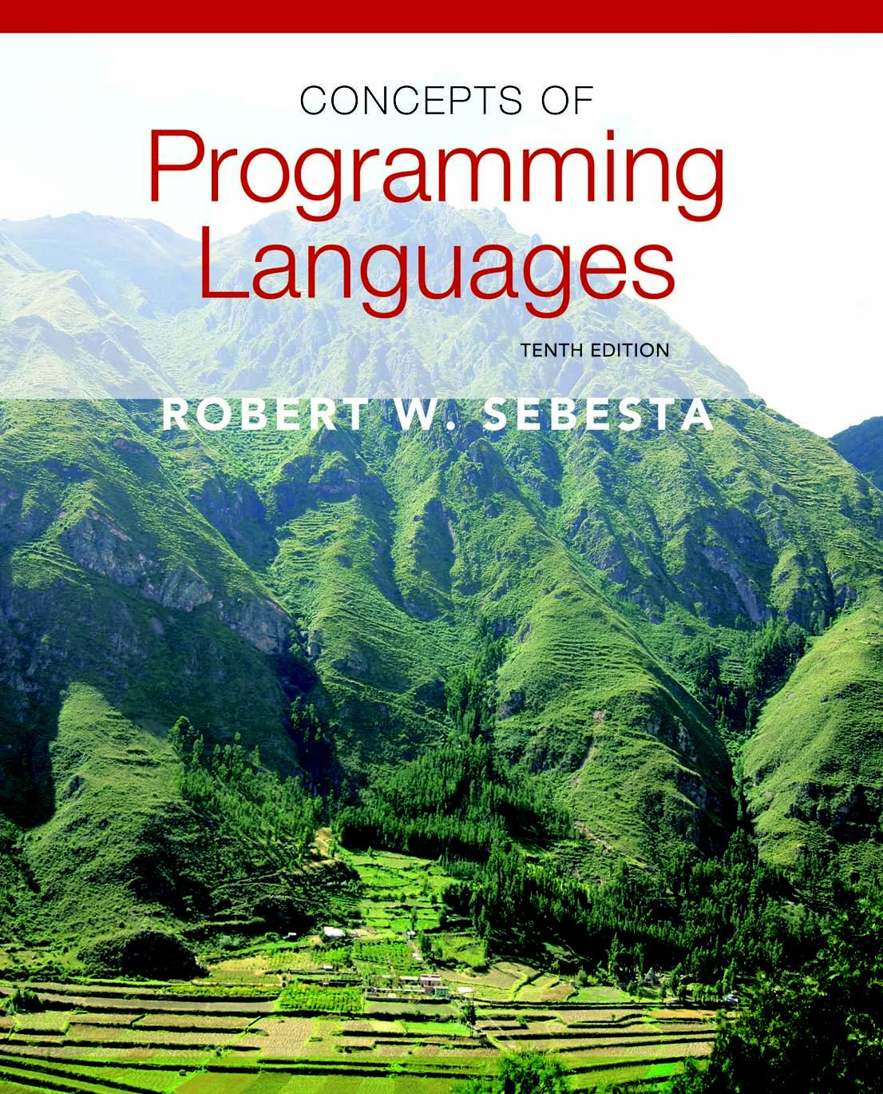
Copyright © 2012 Addison-Wesley. All rights reserved.

Slide 2
Lecture 6: Control Structures
CS4080
(Chapter 8 )

Slide 3
Introduction
Levels of Control Flow
Within expressions (Chapter 7 - Lecture 5)
Among program units (Chapter 9 – Lecture 10)
Among program statements (Chapter 8)
Topics covered in this lecture
Selection Statements
Iterative Statements
Unconditional Branching

Slide 4
Control Structures
A control structure is a control statement including the statements whose execution it controls
Evolution
FORTRAN I control statements were based directly on IBM 704 hardware
Much research and argument in the 1960s
Important result: It was proven that all algorithms represented by flowcharts can be coded with only two-way selection and pretest logical loops
Design question
Should a control structure have multiple entries?

Slide 5
Selection Statements
A selection statement provides the means of choosing between two or more paths of execution
Two general categories:
Two-way selectors
Multiple-way selectors

Slide 6
Two-Way Selection Statements
General form:
if control_expression
then clause
else clause
Design Issues:
What is the form and type of the control expression?
How are the then and else clauses specified?
How should the meaning of nested selectors be specified?
General form:
if control_expression
then clause
else clause
Design Issues:
What is the form and type of the control expression?
How are the then and else clauses specified?
How should the meaning of nested selectors be specified?

Slide 7
The Control Expression
In most languages, the control expression (i.e. the condition) must be a Boolean expression
Ada, Java, Ruby, C#, …
In some languages, the control expression can be an arithmetic expression
C, C++, Python
If “then” reserved word or some other syntactic marker is not used to introduce the then clause, the control expression is placed in parenthesis
Ex1: if (a < b) smaller = a; else smaller = b;
Ex2: if a < b then smaller = a; else smaller = b;

Slide 8
Clause Form
In many contemporary languages, the then and else clauses can be single statements or compound statements
In Perl, all clauses must be delimited by braces (they must be compound)
In Fortran 95, Ada, and Ruby, clauses are statement sequences
Python uses indentation to define clauses
if x > y :
x = y
print "case 1"

Slide 9
Nesting Selectors
Java example
if (sum == 0)
if (count == 0)
result = 0;
else result = 1;
Which if gets the else?

Slide 10
Nesting Selectors
Java example
if (sum == 0)
if (count == 0)
result = 0;
else result = 1;
Which if gets the else?
Java’s static semantic rule:
else matches the nearest if

Slide 11
Nesting Selectors (continued)
To force an alternative semantics, compound statements may be used:
if (sum == 0) {
if (count == 0)
result = 0;
}
else result = 1;
The above solution is used in C, C++, C#, …
Perl requires that all then and else clauses to be compound

Slide 12
Nesting Selectors (continued)
Statement sequences as clauses: Ruby
if sum == 0 then
if count == 0 then
result = 0
else
result = 1
end
end

Slide 13
Nesting Selectors (continued)
Python
if sum == 0 :
if count == 0 :
result = 0
else :
result = 1

Slide 14
Selection as Expression
In ML, F#, and LISP, the selector is an expression
F#
let y =
if x > 0 then x
else 2 * x
- If the if expression returns a value, there must be an else clause (the expression could produce output, rather than a value)

Slide 15
Multiple-Way Selection Statements
Allow the selection of one of any number of statements or statement groups
Design Issues:
What is the form and type of the control expression?
How are the selectable segments specified?
Is execution flow through the structure restricted to include just a single selectable segment?
How are case values specified?
What is done about unrepresented expression values?

Slide 16
Multiple-Way Selection: Examples
C, C++, and Java
switch (expression) {
case const_expr_1: stmt_1;
…
case const_expr_n: stmt_n;
[default: stmt_n+1]
}

Slide 17
Multiple-Way Selection: Examples
Design choices for C’s switch statement
Control expression can be only an integer type
Selectable segments can be statement sequences, blocks, or compound statements
Any number of segments can be executed in one execution of the construct (there is no implicit branch at the end of selectable segments)
default clause is for unrepresented values (if there is no default, the whole statement does nothing)

Slide 18
Multiple-Way Selection: Examples
C#
Differs from C in that it has a static semantics rule that disallows the implicit execution of more than one segment
Each selectable segment must end with an unconditional branch (goto or break)
Also, in C# the control expression and the case constants can be strings

Slide 19
Multiple-Way Selection: Examples
Ada
case expression is
when choice list => stmt_sequence;
…
when choice list => stmt_sequence;
when others => stmt_sequence;]
end case;
More reliable than C’s switch (once a stmt_sequence execution is completed, control is passed to the first statement after the case statement

Slide 20
Multiple-Way Selection: Examples
Ruby has two forms of case statements
1. One form uses when conditions
leap = case
when year % 400 == 0 then true
when year % 100 == 0 then false
else year % 4 == 0
end
2. The other uses a case value and when values
case in_val
when -1 then neg_count++
when 0 then zero_count++
when 1 then pos_count++
else puts "Error – in_val is out of range"
end

Slide 21
Multiple-Way Selection Using if
Multiple Selectors can appear as direct extensions to two-way selectors, using else-if clauses, for example in Python:
if count < 10 :
bag1 = True
elif count < 100 :
bag2 = True
elif count < 1000 :
bag3 = True
Questions: does Python have case/switch like statement?

Slide 22
Multiple-Way Selection Using if
The Python example can be written as a Ruby case
case
when count < 10 then bag1 = true
when count < 100 then bag2 = true
when count < 1000 then bag3 = true
end

Slide 23
Iterative Statements
The repeated execution of a statement or compound statement is accomplished either by iteration or recursion
General design issues for iteration control statements:
1. How is iteration controlled?
2. Where is the control mechanism in the loop?

Slide 24
Counter-Controlled Loops
A counting iterative statement has a loop variable, and a means of specifying the initial and terminal, and stepsize values
Design Issues:
What are the type and scope of the loop variable?
Should it be legal for the loop variable or loop parameters to be changed in the loop body, and if so, does the change affect loop control?
Should the loop parameters be evaluated only once, or once for every iteration?

Slide 25
Iterative Statements: Examples
FORTRAN 95 syntax
DO label var = start, finish [, stepsize]
Stepsize can be any value but zero
Parameters can be expressions
Design choices:
1. Loop variable must be INTEGER
2. The loop variable cannot be changed in the loop, but the parameters can; because they are evaluated only once, it does not affect loop control
3. Loop parameters are evaluated only once

Slide 26
Iterative Statements: Examples
FORTRAN 95 : a second form:
[name:] Do variable = initial, terminal [,stepsize]
…
End Do [name]
- Cannot branch into either of Fortran’s Do statements

Slide 27
Iterative Statements: Examples
Ada
for var in [reverse] discrete_range loop ...
end loop
Design choices:
- Type of the loop variable is that of the discrete range (A discrete range is a sub-range of an integer or enumeration type).
- Loop variable does not exist outside the loop
- The loop variable cannot be changed in the loop, but the discrete range can; it does not affect loop control
- The discrete range is evaluated just once
Cannot branch into the loop body

Slide 28
Iterative Statements: Examples
C-based languages
for ([expr_1] ; [expr_2] ; [expr_3]) statement
- The expressions can be whole statements, or even statement sequences, with the statements separated by commas
The value of a multiple-statement expression is the value of the last statement in the expression
If the second expression is absent, it is an infinite loop
Design choices:
- There is no explicit loop variable
- Everything can be changed in the loop
- The first expression is evaluated once, but the other two are evaluated with each iteration

Slide 29
Iterative Statements: Examples
C++ differs from C in two ways:
The control expression can also be Boolean
The initial expression can include variable definitions (scope is from the definition to the end of the loop body)
Java and C#
Differs from C++ in that the control expression must be Boolean

Slide 30
Iterative Statements: Examples
Python
for loop_variable in object:
- loop body
[else:
- else clause]
The object is often a range, which is either a list of values in brackets ([2, 4, 6]), or a call to the range function (range(5), which returns 0, 1, 2, 3, 4
The loop variable takes on the values specified in the given range, one for each iteration
The else clause, which is optional, is executed if the loop terminates normally

Slide 31
Logically-Controlled Loops
Repetition control is based on a Boolean expression
Design issues:
Pretest or posttest?
Should the logically controlled loop be a special case of the counting loop statement or a separate statement?

Slide 32
Logically-Controlled Loops: Examples
C and C++ have both pretest and posttest forms, in which the control expression can be arithmetic:
while (ctrl_expr) do
loop body loop body
while (ctrl_expr)
Java is like C and C++, except the control expression must be Boolean (and the body can only be entered at the beginning -- Java has no goto

Slide 33
User-Located Loop Control Mechanisms
Sometimes it is convenient for the programmers to decide a location for loop control (other than top or bottom of the loop)
Simple design for single loops (e.g., break)
Design issues for nested loops
Should the conditional be part of the exit?
Should control be transferable out of more than one loop?

Slide 34
User-Located Loop Control Mechanisms break and continue
C , C++, Python, Ruby, and C# have unconditional unlabeled exits (break)
Java and Perl have unconditional labeled exits (break in Java, last in Perl)
C, C++, and Python have an unlabeled control statement, continue, that skips the remainder of the current iteration, but does not exit the loop
Java and Perl have labeled versions of continue

Slide 35
Iteration Based on Data Structures
Number of elements of in a data structure control loop iteration
Control mechanism is a call to an iterator function that returns the next element in some chosen order, if there is one; else loop is terminate
C's for can be used to build a user-defined iterator:
for (p=root; p==NULL; traverse(p)){
}

Slide 36
Iteration Based on Data Structures (continued)
PHP
- current points at one element of the array
- next moves current to the next element
- reset moves current to the first element
Java
- For any collection that implements the Iterator interface
- next moves the pointer into the collection
- hasNext is a predicate
- remove deletes an element
Perl has a built-in iterator for arrays and hashes, foreach

Slide 37
Iteration Based on Data Structures (continued)
Java 5.0 (uses for, although it is called foreach)
- For arrays and any other class that implements
Iterable interface, e.g., ArrayList
for (String myElement : myList) { … }
C#’s foreach statement iterates on the elements of arrays and
other collections:
Strings[] = strList = {"Bob", "Carol", "Ted"};
foreach (Strings name in strList)
Console.WriteLine ("Name: {0}", name);
- The notation {0} indicates the position in the string to be displayed

Slide 38
Unconditional Branching
Transfers execution control to a specified place in the program
Represented one of the most heated debates in 1960’s and 1970’s
Major concern: Readability
Some languages do not support goto statement (e.g., Java)
C# offers goto statement (can be used in switch statements)
Loop exit statements are restricted and somewhat camouflaged goto’s

Slide 39
Conclusion
Variety of statement-level structures
Choice of control statements beyond selection and logical pretest loops is a trade-off between language size and writability
Functional and logic programming languages are quite different control structures

